Slide 1
Global Terrorism Analysis
Capstone Project - I
Priyanka Kolhapure

Slide 2
Basic Data Information
Dimensionality
Time
Countries
The data we used for the analysis is taken from Global Terrorism Database (GTD) and we got total 135 columns and around 181691 records
47 years of terrirism data taken into account for this analysis. That data taken from 1970 to 2017
As we the taken for the analysis consist of total 204 countries across the globe

Slide 3
Data preparation
Missing values
Basic Processing
Feature selection
Missing value treatment
We had almost 50% of columns missing above 80% data, so we dropped those columns
We filled some features using most occurred value which is mode
Replacing and Renaming
Replaced some values with original types
Renamed columns for the better interpretation of while analysis
Required features
Selected only 12 required features for the analysis based on intuition and completeness of data
Further study is based on these selected 12 features

Slide 4
Visualization
max growth
Exploratory Data Analysis

Slide 5
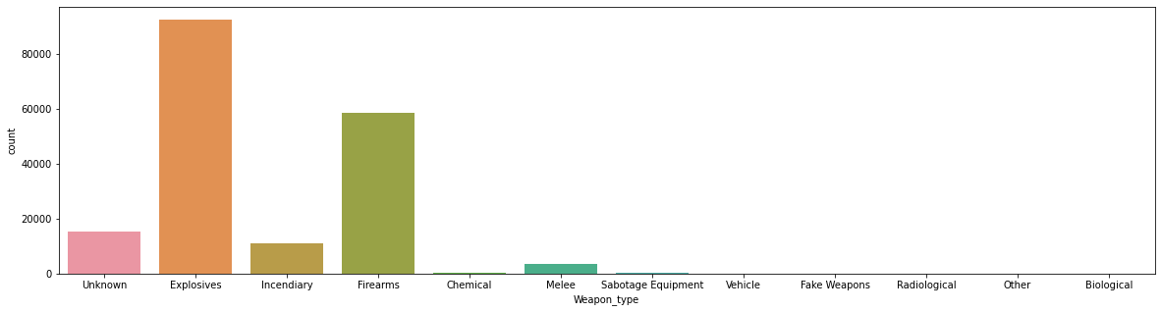
Weapons used in terror attacks
From above fig we can see that most used weapon type for terror attach are Explosives
As we can also conclude that Biological weapons are least used type when it comes to terror attack

Slide 6
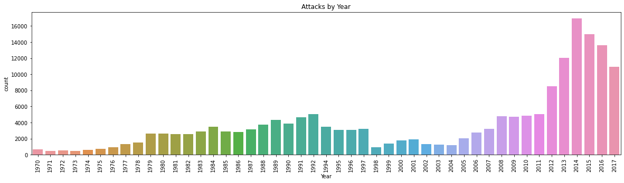
Attack Trend Year-wise
Most attack happened in 2014 as we can see in the graph
If we see the trend, then from 1970 to 1992 attacks were linearly increasing and they dropped till 2004 and again increased drastically and linearly

Slide 7
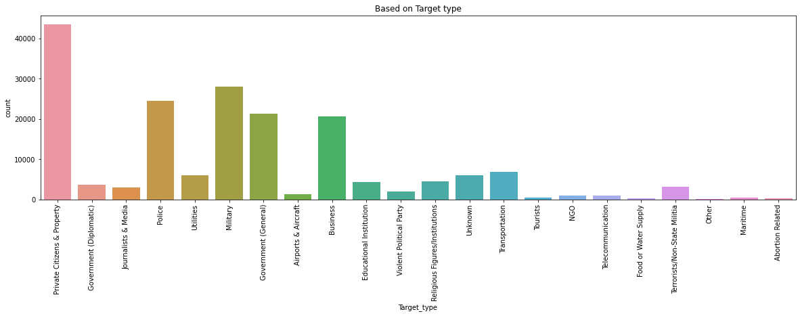
Targeted types by terrorists
As we can clearly see that private citizens and properties are mostly targeted by terrorist, may be because these are most easily accessable places than the rest
Also police and military are the second most targeted types of terrorists.

Slide 8
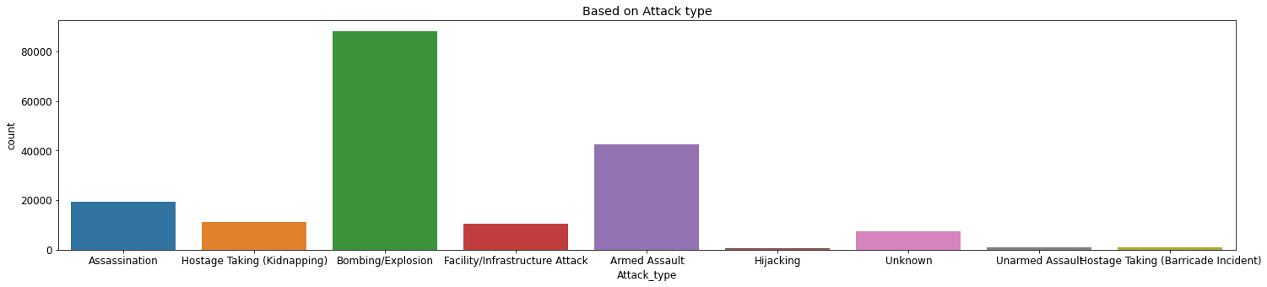
Attack type used
As we can see most attack types used by terrorists are armed assaults and explosives
Also, we can see some attack types unarmed also

Slide 9
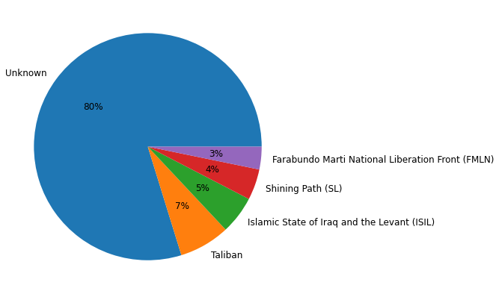
top 5 gangs
As seen in figure below we can see that around 80% attacks done by unknown terrorist groups
Also we can see that second most attacks done by taliban gang

Slide 10
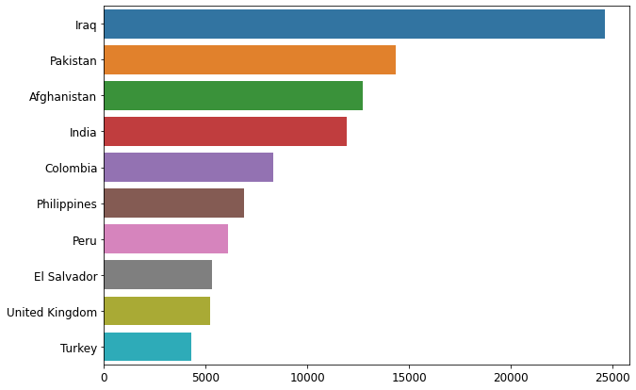
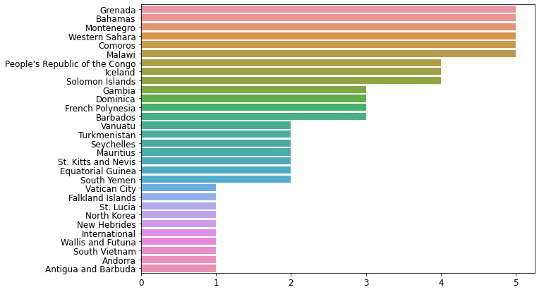
Top most and least countries as per # attacks

Slide 11
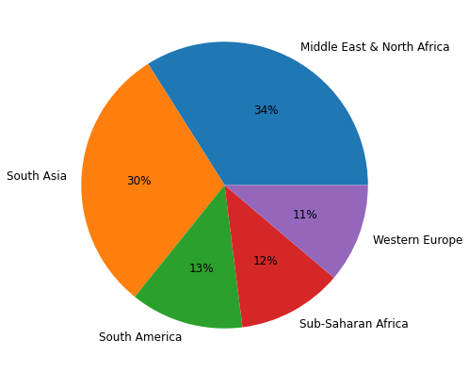
Region wise attacks distribution

Slide 12
Thanks

